Slide 1
CSC4005 High Performance Computing: Principles Of Parallel Programming Lecture 1 INTRO TO PARALLEL PROGRAMMING
Blesson Varghese
b.varghese@qub.ac.uk
www.blessonv.com

Slide 2
Acknowledgements
Prepared from the slides of Dr Ivor Spence, QUB and Dr Peter Kilpatrick, QUB
They acknowledged:
Prof. Stan Scott, QUB.
Blaise Barney, Lawrence Livermore National Laboratory, https://computing.llnl.gov/tutorials
Jack Dongarra, University of Tennessee
Quentin F. Stout Christiane Jablonowski, University of Michigan
Ananth Grama, Anshul Gupta, George Karypis, and Vipin Kumar, “Introduction to Parallel Computing”, Addison-Wesley, 2003.

Slide 3
About the Lecturer
Experience
Education
B.Tech (~UK M.Eng from India) [First rank with distinction]
MSc (Reading) [Distinction]
PhD (Reading)
Worked in the industry
KLA Tencor Corp., USA
Researcher
Halifax(Canada)
St Andrews (Scotland)
Belfast (N. Ireland)
Research Area
High-Performance/Distributed Computing
Cloud/Edge Computing
Want to know about doing a PhD?
Let me know!

Slide 4
About the Lecturer
Experience with this module
Was nominated for a teaching award in 2017-18
Contact
Reachable by email: b.varghese@qub.ac.uk
(Usually) in Room 01.003, Computer Science Building
Note
I have been a student in a final year course!
I fully understand demands, pressures, deadlines etc

Slide 5
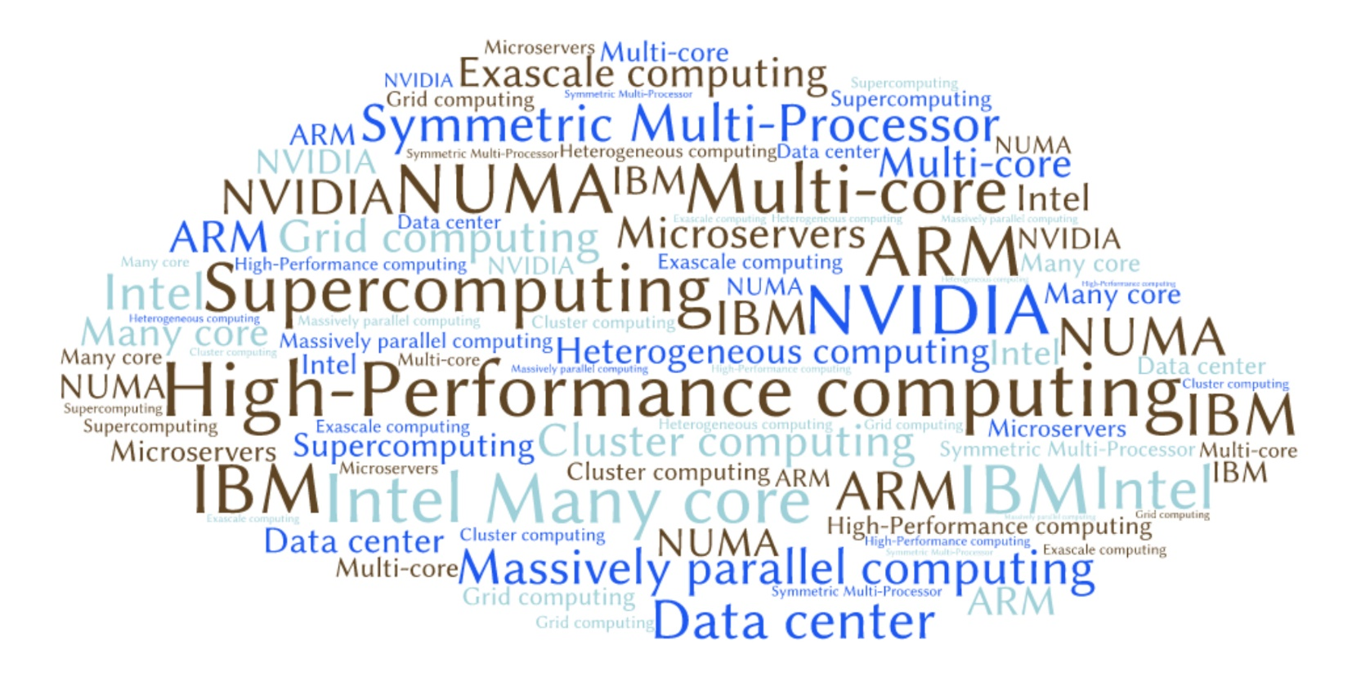
Why study this course?

Slide 6


About the Course
Compulsory Elements
Lectures and Labs
Coursework
Project and Presentation
Written Examination
None!!!

Slide 7
About the Course
You will have:
Lectures + Practical: 10 sessions ~ 60 hours
Informal feedback sessions (Week 3, 5)
To help with coursework
Two sessions for self-study (Week 9, 10)
Some material will be discussed

Slide 8
About the Course
What you will have
Practical sessions with lecture
Reading Assignment: 3 articles
Programming Assignments: 2 (30% + 20%)
Final Programming Project: 1 (50%)
With a project presentation

Slide 9
Deadlines for Marked Coursework (50%)
Assignment 1
Available on: Mon, Sep 24, 13:00
Deadline: Thu, Oct 25, 23:59
Assignment 2
Available on: Mon, Oct 29, 09:00
Deadline: Wed, Nov 14, 23:59
30%
20%

Slide 10
Deadlines for Final Project (50%)
Programming Project (40%):
Available on: Mon, Oct 15, 09:00
Deadline: Thu, Nov 29, 23:59
Assessment: Mon, Dec 3 (details to follow)
Project Presentation (10%)
Deadline: Fri, Dec 7, 23:59
Presentation: Mon, Dec 10 (details to follow)

Slide 11

About the Course
We will aim to learn:
Basic concepts and terminology
Parallel computer memory architectures
Parallel programming models
Designing parallel programs
Future directions in parallel programming

Slide 12

About the Course
The learning outcomes from this course will be:
To understand the principles underpinning effective and efficient parallel programs.
To understand those factors that influence performance.
To appreciate current trends in parallel computing.
To understand the basics of C, OpenMP and MPI.

Slide 13


About the course
Lots of programming!
Programming will be in C, using OpenMP and MPI
On a multi-core High-Performance Computing System at QUB:
Kelvin (more info here)
Coursework assignments and final project are mostly programming tasks

Slide 14

About the Course
The skills you will obtain from this course are:
to design, implement, experiment with and analyse parallel versions of an application program in OpenMP and MPI
to present coherently the results of experiments and findings in both written and oral form
to identify, understand and appreciate high level journal papers on parallel computing
“The expert in anything was once a beginner…”

Slide 15

About the Course
Lecture Slides
Designed for interactive learning
Facilitate both lectures and hands-on in the lab
Additional resources for learning provided as ‘Callouts’ with links to external material
Feel free to provide feedback anytime!
Links to additional resources will be provided in Callouts

Slide 16
About the Course
Please ask questions when things are not clear
Available to meet in office
Most Tuesday’s, 10:00 – 11:30
Course material, content, assignment or project related queries/matters ONLY on discussion forum
Do not use e-mail for the above queries/matters
If you email, you may get a response ‘post on discussion forum’ or may not get a response
E-mail only if necessary and if query is of a personal nature!
If you do, please use ‘[CSC4005]: ….’ in Subject
Aim to respond within 24 hours
Expect a response only during working hours

Slide 17
A note on assignments

Slide 18
A Note on Assignments – Year 1
Problem description/Brief
Deliverable (report + code)
One way to complete an assignment
Multiple waypoints to make sure what you are doing was right

Slide 19
A Note on Assignments – Year 2
Problem description/Brief
Deliverable (report + code)
Multiple ways to complete an assignment
Multiple waypoints along each way to make sure what you are doing was right

Slide 20
A Note on Assignments – Year 3
Problem description/Brief
Deliverable (report + code)
Multiple ways to complete an assignment
Fewer waypoints along each way
Gives you more freedom and independence

Slide 21
A Note on Assignments – Year 4
Problem description/Brief
Deliverable (report + code)
You will receive open ended problems
No one way to complete the assignment; you may be get to the same answer multiple ways
Opportunity to demonstrate that you have learned the concepts well
Don’t expect waypoints
Gives you freedom and independence
Allows you to employ your problem solving skills from outside the course
You will get credit for innovation
Will not be penalised for thinking out of the box as long as you achieve what has been asked for and did not violate any constraints (for example, page/word limit, asked not to do a certain way)

Slide 22
Introduction

Slide 23

What is Parallel Computing?
Traditionally programs were written as sequential programs
Run on a single computer having a single Central Processing Unit (CPU)
A problem is broken into a discrete series of instructions.
Instructions are executed one after another.
Only one instruction may execute at any moment in time.

Slide 24

What is Parallel Computing?
Parallel computing is the simultaneous use of multiple compute resources to solve a computational problem
Run on multiple CPUs
A problem is broken into discrete parts that are solved concurrently
Each part is broken down to a series of instructions
Instructions from each part execute simultaneously on different CPUs
A video on serial vs parallel computing can be found here

Slide 25

Parallelism Examples
Galaxy formation
Planetary movement
Weather and ocean patterns
Tectonic plate drift
Rush hour traffic
Automobile assembly line
Building a space shuttle
Ordering a burger at the drive through
many complex, interrelated events happening at the same time, yet within a sequence

Slide 26


Parallelism Uses
Domains: Physics, Bioscience, Engineering, Earth Science, Atmosphere, Geology, Chemistry, Molecular Science…
Commercial applications: Oil and Gas, Financial engineering, advanced graphics, medical imaging, virtual reality….
Example paint application here
to model difficult scientific and engineering problems found in the real world
large amounts of data in sophisticated ways

Slide 27
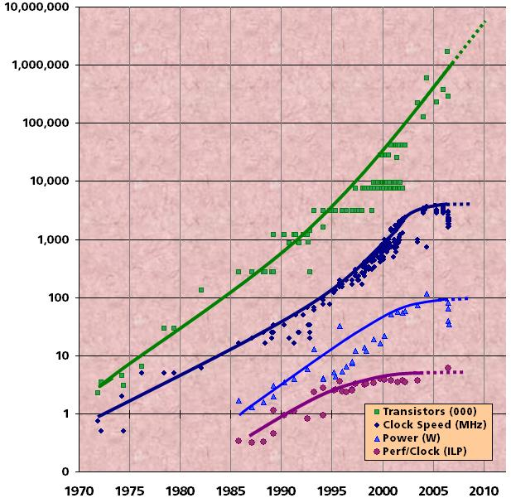
Face the Inevitable, Embrace Parallelism
A few decades ago processors became faster each year (measured by clock speed)
Now clock speed is not becoming faster – fixed or may be even slower
But things are still doubling every 18-24 months
Moore’s law reinterpreted
Number of cores are doubling every 18-24 months
Notes:
ILP: Instruction Level Parallelism

Slide 28
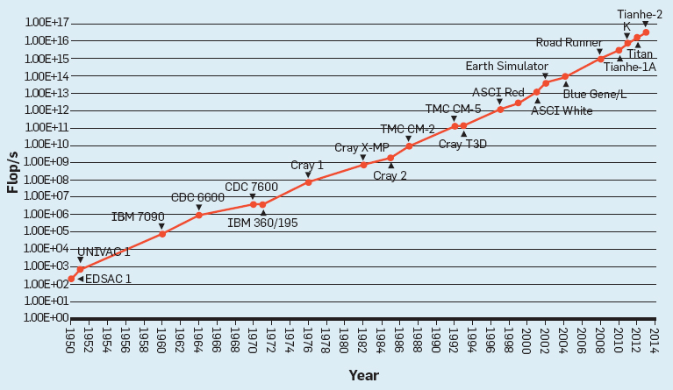
Face the Inevitable, Embrace Parallelism
Although clock speeds are not increasing, computing power still is

Slide 29
Face the Inevitable, Embrace Parallelism
What does it mean if the number of cores are doubling every year?
The number of executing threads will double
We need to deal with systems that execute millions of concurrent threads
Future generation systems will have billions of concurrent threads
We need to improvise parallel programming
People like you with parallel programming skills are required to develop the software technology to deal with this!

Slide 30

Measuring Computing Power
Top500 lists the fastest computer systems in the world today
Has been updated twice a year since 1993
The LINPACK benchmark is used to measure performance – system with lowest execution time ranks highest.
Visit www.top500.org
Video on what is a benchmark is here, and on types of benchmarks is here

Slide 31
Top 5 in Top 500 (June 2018)
Rank | System | Location | Cores | Max Tflops/s | Power (kW)
1 | Summit | USA | 2,282,544 | 122,300.0 | 8,806
2 | Sunway TaihuLight | China | 10,649,600 | 93,014.6 | 15,371
3 | Sierra | USA | 1,572,480 | 19,590.0 | NA
4 | Tianhe-2A | China | 4,981,760 | 17,590.0 | 18,482
5 | AI Bridging Cloud Infrastructure (ABCI | Japan | 391,680 | 17,173.2 | 1,649

Slide 32
Top 5 in Top 500 (June 2017)
Rank | System | Location | Cores | Max Tflops/s | Power (kW)
1 | Sunway TaihuLight | China | 10,649,600 | 93,014.6 | 15,371
2 | Tianhe-2 | China | 3,120,000 | 33,862.7 | 17,808
3 | Piz Daint | Switzerland | 361,760 | 19,590.0 | 2,272
4 | Titan | United States | 560,640 | 17,590.0 | 8,209
5 | Sequoia | United States | 1,572,864 | 17,173.2 | 7,890

Slide 33
Top 7 UK Systems in Top 100 (June 2018)
Rank | System | Location | Cores | Max Tflops/s | Power (kW)
20 | UK Meteorological Office | Exeter | 241,920 | 7,038.9 | 3,629
36 | European Centre for Medium-Range Weather Forecasts (ECMWF) | Reading | 126,468 | 3,944.7 | 1,897
37 | ECMWF | Reading | 126,468 | 3,944.7 | 1,897
47 | Atomic Weapons Establishment (AWE) | Aldermaston | 113,832 | 3,243.4 | 1,134
59 | UK Meteorological Office | Exeter | 89,856 | 2,801.8 | 1,348
60 | UK Meteorological Office | Exeter | 89,856 | 2,801.8 | 1,348
91 | Science and Technology Facilities Council | Swindon | 80,640 | 1,829.9 | 529

Slide 34
Top 8 UK Systems in Top 500 (June 2017)
Rank | System | Location | Cores | Max Tflops/s | Power (kW)
11 | UK Meteorological Office | Exeter | 241,920 | 7,038.9 | 3,629
25 | European Centre for Medium-Range Weather Forecasts (ECMWF) | Reading | 126,468 | 3,944.7 | 1,897
26 | ECMWF | Reading | 126,468 | 3,944.7 | 1,897
42 | UK Meteorological Office | Exeter | 89,856 | 2,801.8 | 1,348
43 | UK Meteorological Office | Exeter | 89,856 | 2,801.8 | 1,348
73 | EPSRC/University of Edinburgh - Archer | Edinburgh | 118,080 | 1,642.5 | 3,306
79 | STFC – Blue Joule | Warrington | 131,072 | 1,431.1 | 657
100 | University of Cambridge - Wilkes | Cambridge | 21,240 | 1,193.0 | 114

Slide 35

Measuring Computing Power
If you want to find the computing power of your desktop or laptop, then try installing and running LINPACK:
https://www.top500.org/project/linpack/
Compare your computer system to the Top500!

Slide 36
Wider Problems with Massive Parallelism
More scalable parallel programming models are required to deal with millions-billions of threads
Another problem is power (and energy consumption):
Some of the top computer systems in Top500 require ~18 MW
Equivalent to electricity generated by a wind power electric station in Northern Ireland
Let’s say 1 MW ~ 1000 homes in the UK; nearly 15,000 homes in the UK can be powered
Data centers in the US consume ~2% of the country’s total energy
Energy consumed by ~6.4 million average US homes

Slide 37

Measuring Computing Power with Energy
Top500 does not consider energy efficiency
Green500 launched to rank top 500 energy efficient computer systems
Since 2007, published twice a year
Visit https://www.top500.org/green500/
Details of power measurement method is available here

Slide 38
Top 6 in Green 500 (June 2018)
Rank | Rank in Top500 | System | Location | Cores | Power (kW) | Power Efficiency (Gflops/watts)
1 | 359 | Shoubu system B | Japan | 794,400 | 47 | 18.404
2 | 419 | Suiren2 | Japan | 762,624 | 47 | 16.835
3 | 385 | Sakura | Japan | 794,400 | 50 | 16.657
4 | 227 | DGX SaturnV Volta | USA | 22,440 | 97 | 15.113
5 | 1 | Summit | USA | 2,282,544 | 8,806 | 13.889
6 | 19 | TSUBAME3.0 | Switzerland | 135,828 | 2,272 | 13.704

Slide 39
Top 6 in Green 500 (June 2017)
Rank | Rank in Top500 | System | Location | Cores | Power (kW) | Power Efficiency (Gflops/watts)
1 | 61 | TSUBAME3.0 | Japan | 36,288 | 142 | 14.110
2 | 465 | Kukai | Japan | 10,080 | 33 | 14.046
3 | 148 | AIST Al Cloud | Japan | 23,400 | 76 | 12.681
4 | 305 | Raiden GPU Subsystem | Japan | 11,712 | 60 | 10.603
5 | 100 | Wilkes-2 | Cambridge, UK | 21,240 | 114 | 10.428
6 | 3 | Piz Daint | Switzerland | 361,760 | 2,272 | 10.398

Slide 40
Updates from the Market
Computing magnitude – measured in Floating Point Operations per Second (FLOPS)
Terascale (10¹²)
First machine in 1997
IBM Watson ~80 TFLOPS
IBM BlueGene/L ~478 TFLOPS (2007)
Petascale (10¹⁵)
First machine in 2009
Sunway TaihuLight ~93 PFLOPS (July 2017)
Exascale (10¹⁸)
Aspiration for parallel computing researchers (2020?)
Keep track of advances in HPC at www.hpcwire.com
Find more on Exascale Computing here and here

Slide 41
Reading Assignment
K. Asanovic, R. Bodik, J. Demmel, T. Keaveny, K. Keutzer, J. Kubiatowicz, N. Morgan, D. Patterson, K. Sen, J. Wawrzynek, D. Wessel, K. Yelick, “A View of the Parallel Computing Landscape,” Communications of the ACM, Vol. 52, No. 10, pp. 56-67, 2009.
The PDF articles are available on QOL under Resources -> Assignments -> Assignment-0
D. A. Reed, J. Dongarra, “Exascale Computing and Big Data,” Communications of the ACM, Vol. 58, No. 7, pp. 56-68, 2015.
H. Sutter, “The Free Lunch Is Over: A Fundamental Turn Toward Concurrency in Software,” Dr. Dobbs Journal, Vol. 30, No. 3, 2005.

Slide 42
Recap
What is parallel computing?
Different from sequential computing
Parallelism examples and uses
Challenges with embracing parallelism
At the software level – programming techniques
Energy efficiency
Top 500 and Green 500
Awaiting Exascale computing
Don’t forget the reading assignment!
Next item – Concepts and Terminology

Slide 43
Concepts and terminology

Slide 44
What we aim to cover…
Concepts and Terminology
von Neumann Architecture
Flynn’s Taxonomy
Miscellaneous Definitions in Parallel Computing
Overheads in Parallel Programs
Executing a sequential C program
Developing and running a sequential matrix multiplication program on the Kelvin cluster

Slide 45
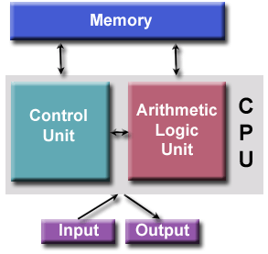
von Neumann Architecture
Named after the Hungarian mathematician John von Neumann
He first authored the general requirements for an electronic computer in his 1945 papers
Since then, virtually all computers have followed this basic design
Comprises four main components:
Memory
Control Unit
Arithmetic Logic Unit
Input/Output

Slide 46
von Neumann Architecture
Read/write, random access memory is used to store both program instructions and data
Program instructions are coded data which tell the computer to do something
Data is simply information to be used by the program
Control unit fetches instructions/data from memory, decodes the instructions and then sequentially coordinates operations to accomplish the programmed task.
Arithmetic Unit performs basic arithmetic operations
Input/Output is the interface to the human operator
Find a video on the von Neumann architecture here

Slide 47
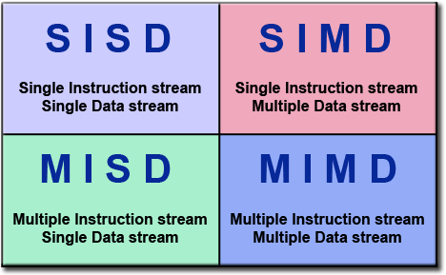
Flynn’s Taxonomy
Provides one way to classify parallel computers
In use since 1966
Distinguished processors on the independent dimensions of Instruction and Data
Each dimension has two states: single/multiple
Videos on Flynn’s Taxonomy are here and here

Slide 48
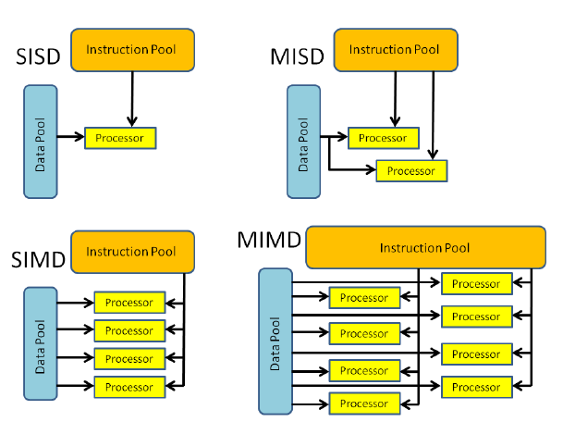
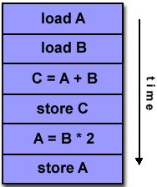
Flynn’s Taxonomy
Single Instruction, Single Data (SISD)
A non-parallel computer
Single instruction: only one instruction stream is being acted on by the CPU during any one clock cycle
Single data: only one data stream is being used as input during any one clock cycle
Deterministic execution
This is the oldest and even today, the most common type of computer
Examples: older generation mainframes, minicomputers and workstations

Slide 49
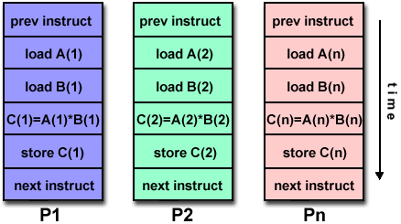
Flynn’s Taxonomy
Single Instruction, Multiple Data (SIMD)
A type of parallel computer
Single instruction: All processing units execute the same instruction at any given clock cycle
Multiple data: Each processing unit can operate on a different data element
Problems with high degree of regularity

Slide 50
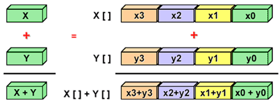
Flynn’s Taxonomy
Single Instruction, Multiple Data (SIMD) (contd.)
Synchronous (lockstep) and deterministic execution
Two varieties:
Processor Arrays: Connection Machine CM-2, MasPar MP-1 & MP-2, ILLIAC IV
Vector Pipelines: IBM 9000, Cray X-MP, Y-MP & C90, ETA10
Graphics Processor Units (GPUs), employ SIMD instructions

Slide 51
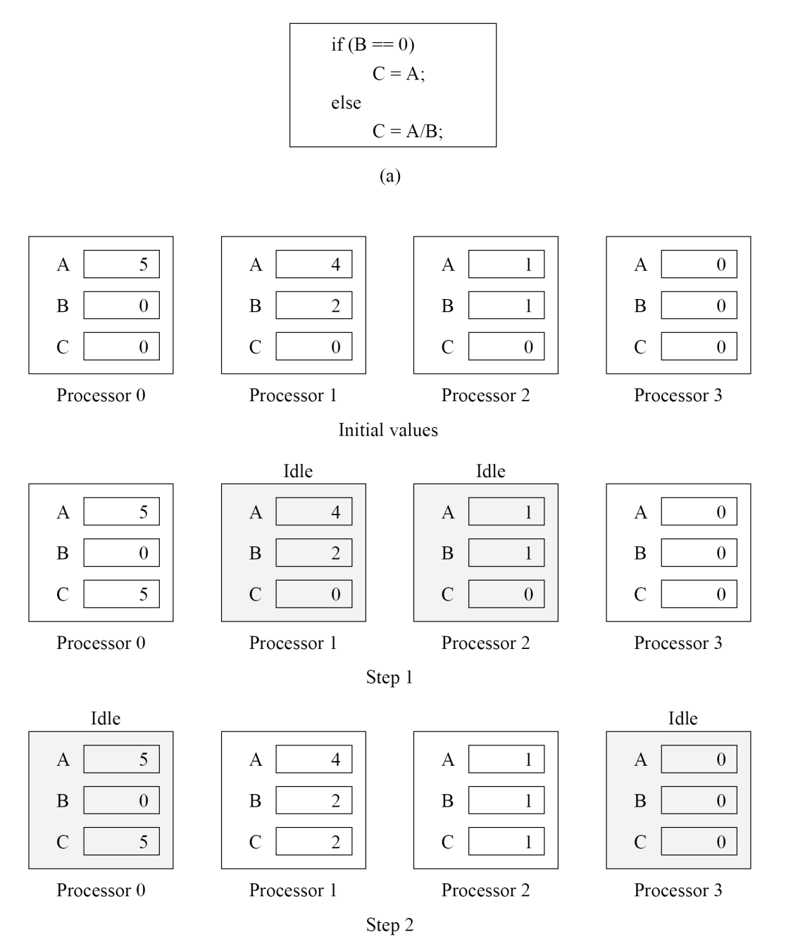
Flynn’s Taxonomy
Single Instruction, Multiple Data (SIMD) (contd.)
Executing a branch instruction
Example has four processors
The conditional statement executes in two steps

Slide 52
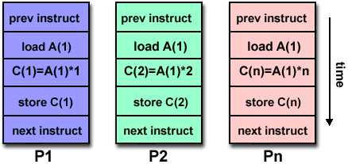
Flynn’s Taxonomy
Multiple Instruction, Single Data (MISD)
A single data stream is fed into multiple processing units
Each processing unit operates on the data independently via independent instruction streams
Few actual examples
Experimental Carnegie-Mellon C.mmp computer (1971).
Uses:
multiple cryptography algorithms attempting to crack a single coded message

Slide 53
Flynn’s Taxonomy
Multiple Instruction, Single Data (MISD) (contd.)
Uses?
Multiple cryptography algorithms attempting to crack a single coded message
The Space Shuttle Computer System used a MISD computer
Alfred Spector and David Gifford, The Space Shuttle Primary Computer System, Communications of the ACM, Vol. 27, Issue 9, September 1984, pp. 872-900.
PDF is here

Slide 54
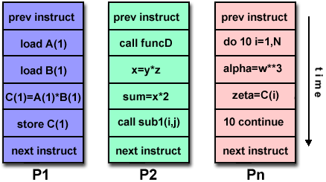
Flynn’s Taxonomy
Multiple Instruction, Multiple Data (MIMD)
Most common type of parallel computer
Multiple Instruction: every processor may be executing a different instruction stream
Multiple Data: every processor may be working with a different data stream
Execution can be synchronous or asynchronous, deterministic or non-deterministic

Slide 55
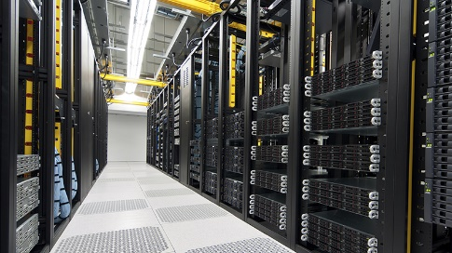
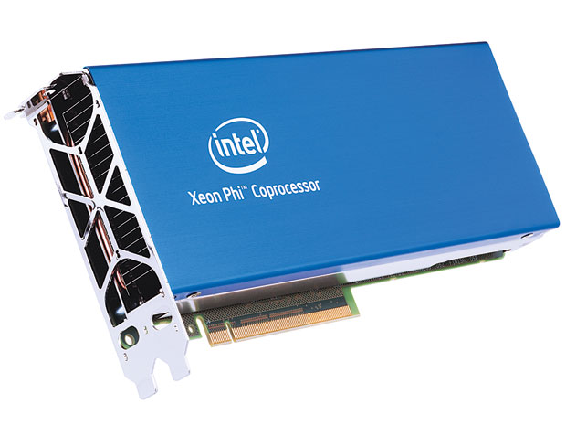

Flynn’s Taxonomy
Multiple Instruction, Multiple Data (MIMD) (contd.)
Examples
most current supercomputers
networked parallel computer clusters and "grids“
multi-processor SMP computers
multi-core PCs
Cloud-based systems

Slide 56
Definitions
Task
A logically discrete section of computational work
Typically a program or program-like set of instructions executed by a processor
Parallel Task
A task executed by multiple processors
Yields correct results
Serial Execution
One instruction at a time is executed
On a single processor machine
Note: All parallel programs will have sections that will need to be executed sequentially

Slide 57
Definitions
Video on pipelining is here
Pipelining
Breaking a task into steps performed by different processors
Like an assembly line
a type of parallel computing
Shared Memory
From a hardware point of view
All processors have direct (usually bus based) access to common physical memory
From a programming point of view
All parallel tasks have the same "picture" of memory
Can directly address and access the same logical memory locations regardless of where the physical memory actually exists
Videos on shared memory are here and here

Slide 58
Definitions
Symmetric Multi-Processor (SMP)
Multiple processors share a single address space
They have access to all resources
Shared memory computing
Distributed Memory
Hardware point of view
Network based memory access for physical memory that is not common.
Programming point of view
Tasks can only logically "see" local machine memory
Must use communications to access memory on other machines where other tasks are executing.
Video on distributed memory is here

Slide 59
Definitions
Communications
Parallel tasks typically need to exchange data
Many ways to do this:
through a shared memory bus or over a network,
The actual event of data exchange is commonly referred to as communications regardless of the method employed
Synchronisation
The coordination of parallel tasks in real time, very often associated with communications.
Usually implemented by providing a synchronisation point within an application
a task may not proceed further until another task(s) reaches the same or logically equivalent point
Involves waiting by at least one task, and can therefore cause a parallel application's wall clock execution time to increase
Video links to synchronisation is here and here

Slide 60
Definitions
Granularity
Qualitative measure of the ratio of computation to communication
Coarse: relatively large amounts of computational work are done between communication events
Fine: relatively small amounts of computational work are done between communication events
Observed Speedup
Defined as:
Wall clock time for serial execution / Wall clock time for parallel execution

Slide 61
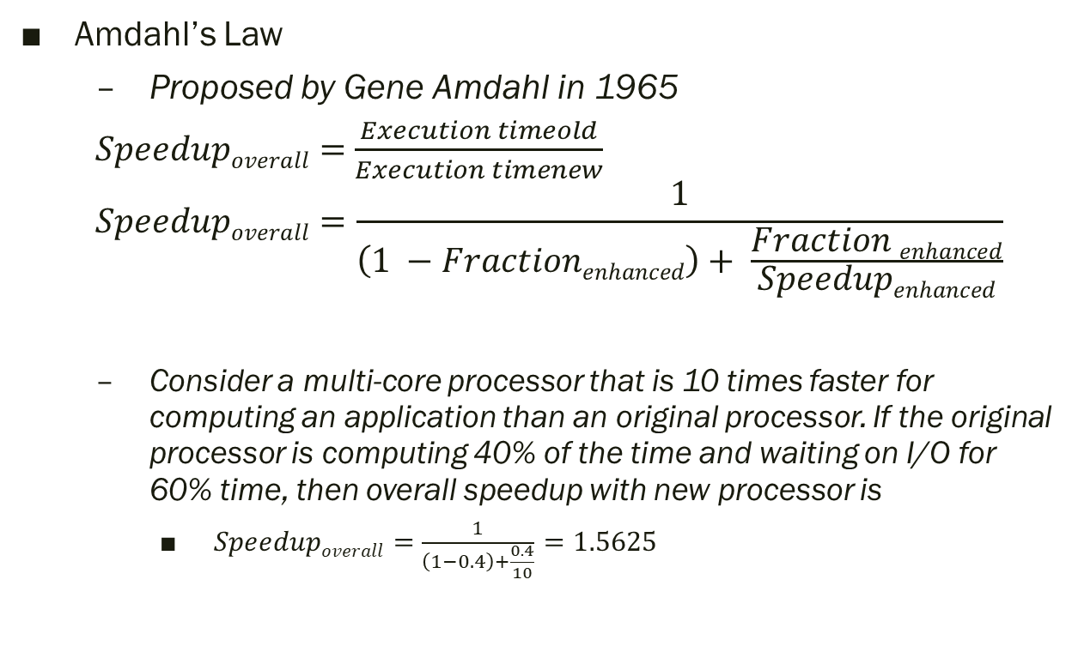
Definitions
Video links to Amdahl’s law here and here
Amdahl’s Law
Proposed by Gene Amdahl in 1965
$Speedupoverall=$ $\frac{Execution timeold}{Execution timenew}$
$$Speedupoverall=\frac{1}{\left(1 −Fractionenhanced\right)+ \frac{Fraction enhanced}{Speedupenhanced}}$$
Consider a multi-core processor that is 10 times faster for computing an application than an original processor. If the original processor is computing 40% of the time and waiting on I/O for 60% time, then overall speedup with new processor is
$Speedupoverall=$ $\frac{1}{\left(1−0.4\right)+\frac{0.4}{10}}$ $=1.5625$

Slide 62
Definitions
Massively Parallel
Hardware of a parallel system having many processors
“Many" keeps increasing
Largest parallel computers can be comprised of hundreds of thousands of processors
Embarrassingly Parallel
Solving many similar, but independent tasks simultaneously
Little or no need for coordination among the tasks.
Ideal form of parallelism
Some additional information on embarrassingly parallel is available here

Slide 63
Definitions
Parallel Overhead
The amount of time required to coordinate parallel tasks, as opposed to doing useful work.
Parallel overhead can include factors such as:
Task start-up time
Synchronisations
Data communications
Software overhead imposed by parallel compilers, libraries, tools, operating system, etc.
Task termination time

Slide 64
Definitions
Overheads in Parallel Programs
If I use two processors, shouldn’t my program run twice as fast?
No - a number of overheads, including wasted computation, communication, idling, and contention cause degradation in performance
Example execution profile highlights this

Slide 65
Definitions
Overheads in Parallel Programs (contd.)
Interprocess interactions
Processors working on any non-trivial parallel problem will need to talk to each other
Not embarrassingly parallel
Idling
Processes may idle because of load imbalance, synchronisation, or serial components.
Excess Computation
Computation not performed by the serial version
May be because the serial algorithm is difficult to parallelise, or
Some computations are repeated across processors to minimise communication.

Slide 66
Definitions
Scalability
Parallel system's (hardware and/or software) ability to demonstrate an increase in parallel speedup with more processors.
Factors that contribute to scalability include:
Hardware - particularly memory-CPU bandwidths and network communications
Application algorithm
Parallel overhead related
Characteristics of your specific application and coding
Interesting link to a video on an example on scalability is here

Slide 67
Definitions
Multi-core Processors
Multiple processors (cores) on a single chip
Cluster Computing
Combination of commodity units (processors, networks or SMPs) to build a parallel system
Supercomputing/High-Performance Computing
Use of the world's fastest, largest machines to solve large problems
Link to students building a cluster at a university is here
You can build a computer cluster at home. Video link is here

Slide 68
Recap…
von Neumann Architecture
Flynn’s Taxonomy
Miscellaneous Definitions in Parallel Computing
Overheads in Parallel Programs
Next item for today: Unix and C Programming

Slide 69
TUTORIAL: UNIX and C programming

Slide 70
Tutorial: Unix and C Programming
Using Unix on lab machines
Go to C:/Vbox/csc4005 folder
Open the Ubuntu image in Oracle Virtual Box
Password to enter is ‘labcsc4005’
After boot up of Ubuntu click on File Manager
Click on Connect to Server
Use the following path to connect:
smb://nas02.eeecs.qub.ac.uk/Menghome/<studentno.>

Slide 71
Tutorial: Unix and C Programming
Using Unix on lab machines (contd.)
Use the following information for connecting
Select ‘Registered user’
Username: <your student no.>
Domain: eeecs
Password: <your password>
Select ‘Remember password until you logout’

Slide 72
Tutorial: Unix and C Programming
Go to Resources -> Tutorials -> Tutorial-1
Unix Tutorials
Tutorial 1a - Complete the tutorials available on QOL in Resources -> Tutorials folder
C Programming Tutorials
Tutorial 1b - Read the EssentialC.pdf available on QOL in Resources -> Tutorials folder
Tutorial 1c - Complete the tutorials available on QOL in Resources -> Tutorials folder

Slide 73
Tutorial: Unix and C Programming
C Programming Tutorials
Note: Work from the I: drive in your account
it is accessible from Virtual Box
Use an editor to write the program
For example, nano (is also available on the cluster)
Command to compile a C program
gcc <filename.c> -o <outputname>
Executing the compiled program
./outputname

Slide 74
Next Time…
Parallel computer memory architectures
Parallel computer programming models
Executing programs on the Kelvin cluster
Before then complete the Unix and C programming tutorials!
Note:
Please feel free to ask if anything its not clear!
Post queries on Discussion Forum not on e-mails.
If there is a query on Discussion Forum and you know the answer to it, please attempt answering it.

